Slide 1

Career in Agriculture
Presented By :Shyam Ambilkar

Slide 2
1
WHY JOB SERCH

Slide 3
The job search process is a never-ending process, it is continuous.
The average American changes jobs a total of seven times and careers three times.
The way that you conduct your job search will directly influence the career path that you take.

Slide 4

Who
Tianjian Meng
Jiawen Peng
Weijian Li

Slide 5
What
Single Integrated Application
Easy Configuration
Secure Role based Access
SMART CAMPUS
Friendly environment
GFM Activity
Attendance Report Generator
Popular Technology Stack

Slide 6



How
02.Java
01.Android + SDK
Java is a programming language.
Java is used to develop mobile apps, web apps, desktop apps, games and much more.
Android Studio provides the fastest tools for building apps on every type of Android
03.PHP
04.MySQL
PHP is a server scripting language, and a powerful tool for making dynamic and interactive Web pages. PHP is a widely-used, free, and efficient
The most comprehensive set of advanced features, management tools and technical support to achieve the highest levels of MySQL scalability, security

Slide 7
2
What we have done

Slide 8

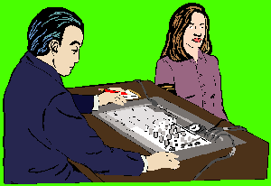


Exploring Your Interests
Realistic
Investigative
Where
are
you?
Conventional
Artistic
Enterprising
Social

Slide 9
What we plan to do
1
Building Developing Environment
Storyboard: Strategic Planning
2
3
Implementation and Evaluation
Operation and Maintenance
4

Slide 14
3
What we have met

Slide 15

What we have met
XAMPP Configuration
We are suffering.
PHP REST Framework
We are suffering.
Android app building Environment
We are suffering.

Slide 16
4
What we will do

Slide 17
What we will do
Always believe that something wonderful is about to happen.
Implement smart campus functions
01
03
Android
UI
02
Data Flow
Design and implement all the other user interface.
Connecting frontend and backend

Slide 18
Q & A

Slide 19
Thanks

